Slide 1
CX Labs Internship at Cisco
Jordan Neville and Archie McMaster
CX Labs UK – Cisco Reading
7th October 2019
Notes:
I want this to be in informal session! Questions as we go.

Slide 2
Agenda
Who are we?
About Cisco
Introduction to CX Labs
CX Labs Internship
Working at Cisco
Learning and Certifications
Q&A

Slide 3

5 Years Career Track to:
Intern at Cisco
Network Security Student @ Solent
Received a 2/1 in my second year
CCNA
Start at Cisco July 1st
CX labs intern at Cisco
Aiming to:
Pass CCNA by February
Attempt CCNP by June
Applied for the Cisco Job
Jordan Neville
Started University
Worked as a Chef
Finished college with D*D*D*
Received a 2/1 in my first year
I did an Apprenticeship in Data Communications

Slide 4

5 Years Career Track to:
Intern at Cisco
Network Security Student @ Solent
Start at Cisco July 30th
CCNA
Passed ICND1v2
SVS intern at Cisco
Aiming to:
Pass ICND2 R&S by December
Attempt CCNP by March
Worked small tasks on company network
Archie McMaster
Attained 1st in first year
Worked for John Lewis
Finished college with 3 A levels: D,D,E
Worked in Call Center alongside second year.
Started Network Security Management at Solent

Slide 5
About Cisco

Slide 6

Who are Cisco?
Largest provider of network hardware in the world
Founded in 1984 by Leonard Bosack and Sandy Lerner
Head office is in San Jose, California
Employs over 72,000 people globally
Over 200 offices in over 90 countries worldwide

Slide 7

Notes:
The point of this is more to give you an informative message.
City verve - https://www.information-age.com/smart-city-lessons-123474272/

Slide 8










What is CX Labs?
Customer Experience Labs- https://www.cxlab.co.uk/
Replicate customer networks in the lab, validating designs and technology integration
CX Labs team has one of the highest concentrations of CCIE within Cisco
Over 250 engineers, 134 active CCIEs.
Locations World-Wide - San Jose USA, Reading UK, Tel Aviv Israel, Sydney Australia, Tokyo Japan, Brussels Belgium
Lab of around 250 racks and 30 Engineers based in Green Park, Reading

Slide 9
CX Labs Internship

Slide 10
Internship Position
13 month placement
Competitive salary
Main focus of role:
Lab administration
Test bed builds and test support
Configuration

Slide 11
Role of the Interns in CX Labs
Lab Administration
Helping maintain and troubleshoot lab infrastructure
Terminal Servers
Management network
Keeping rack power usage and temperature in check
Keeping lab inventory up to date and accurate
E-Wasting old equipment
Processing and working with brand new equipment
Configuration
Manage the projects in the lab:
Working with Engineers to Understand Technologies
Applying and troubleshooting Advanced Configuration
Taking on the Role of a Junior NCE to support testing

Slide 12
Role of the Interns in CX Labs
Test bed builds and testing
Support to engineers on a per-project basis:
Locate and rack appropriate devices
Interconnect devices according to network topology
Apply base configuration such as VRF and VDC setup
Assist with troubleshooting where required
The more you put in the more you get out:
Work on testing and development with CCIE level engineers
Opportunities to work on cutting edge technologies (NSO, ACI, SDN and automation)

Slide 13
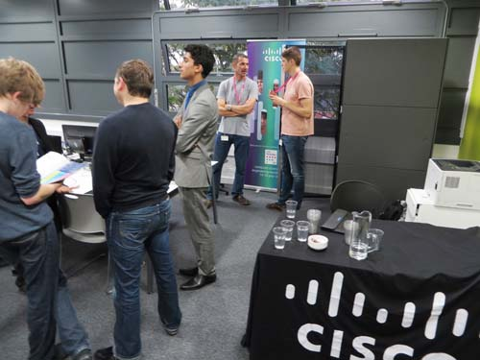
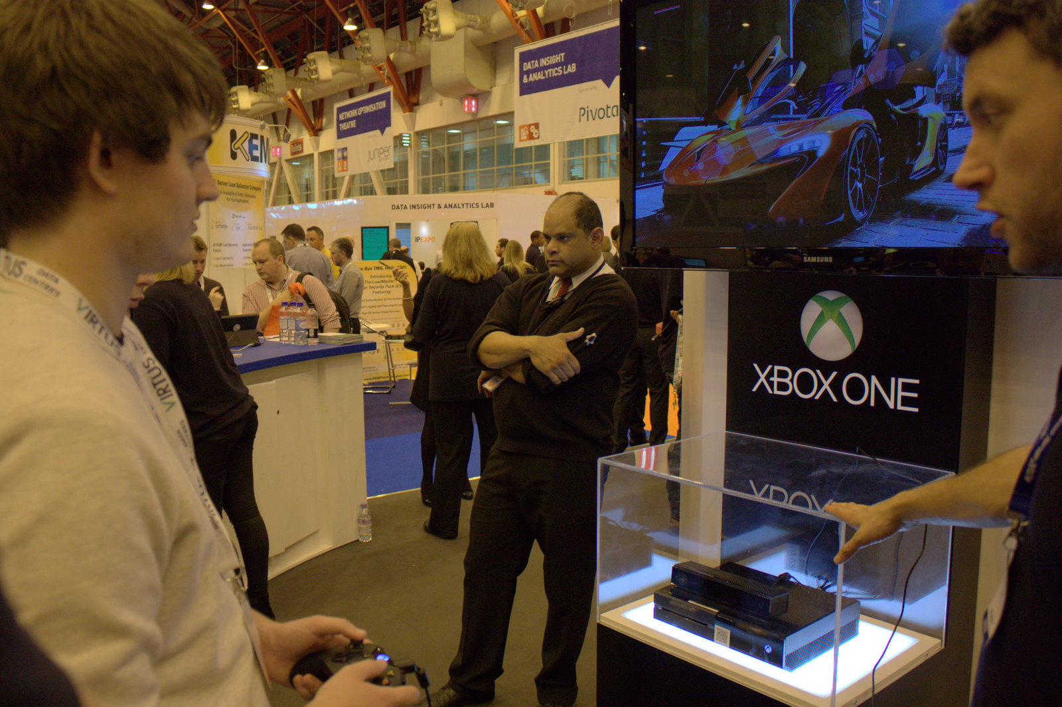
Working at Cisco
Supportive team environment
EVERYBODY is learning new things all the time
Extra-curricular activities:
Departmental events (meal/drinks)
Days out (Sailing, Exhibitions, Cisco Live etc.)
Potential international travel
Sports – weekly badminton club, football
Working with education partners

Slide 14
Learning and Certifications
Manage your own projects (lab infrastructure):
VMware infrastructure (vCenter)
DMZ
Lab management tool development
Monthly mentor meetings
Keep you on track for Certifications!
Opportunities for learning:
Access to a wide range of equipment such as Catalyst, Nexus, ASR, UCS, ASA, Firepower and ACI
CCNA, CCNP and beyond
Learn something new every day
Free books & exams!

Slide 15
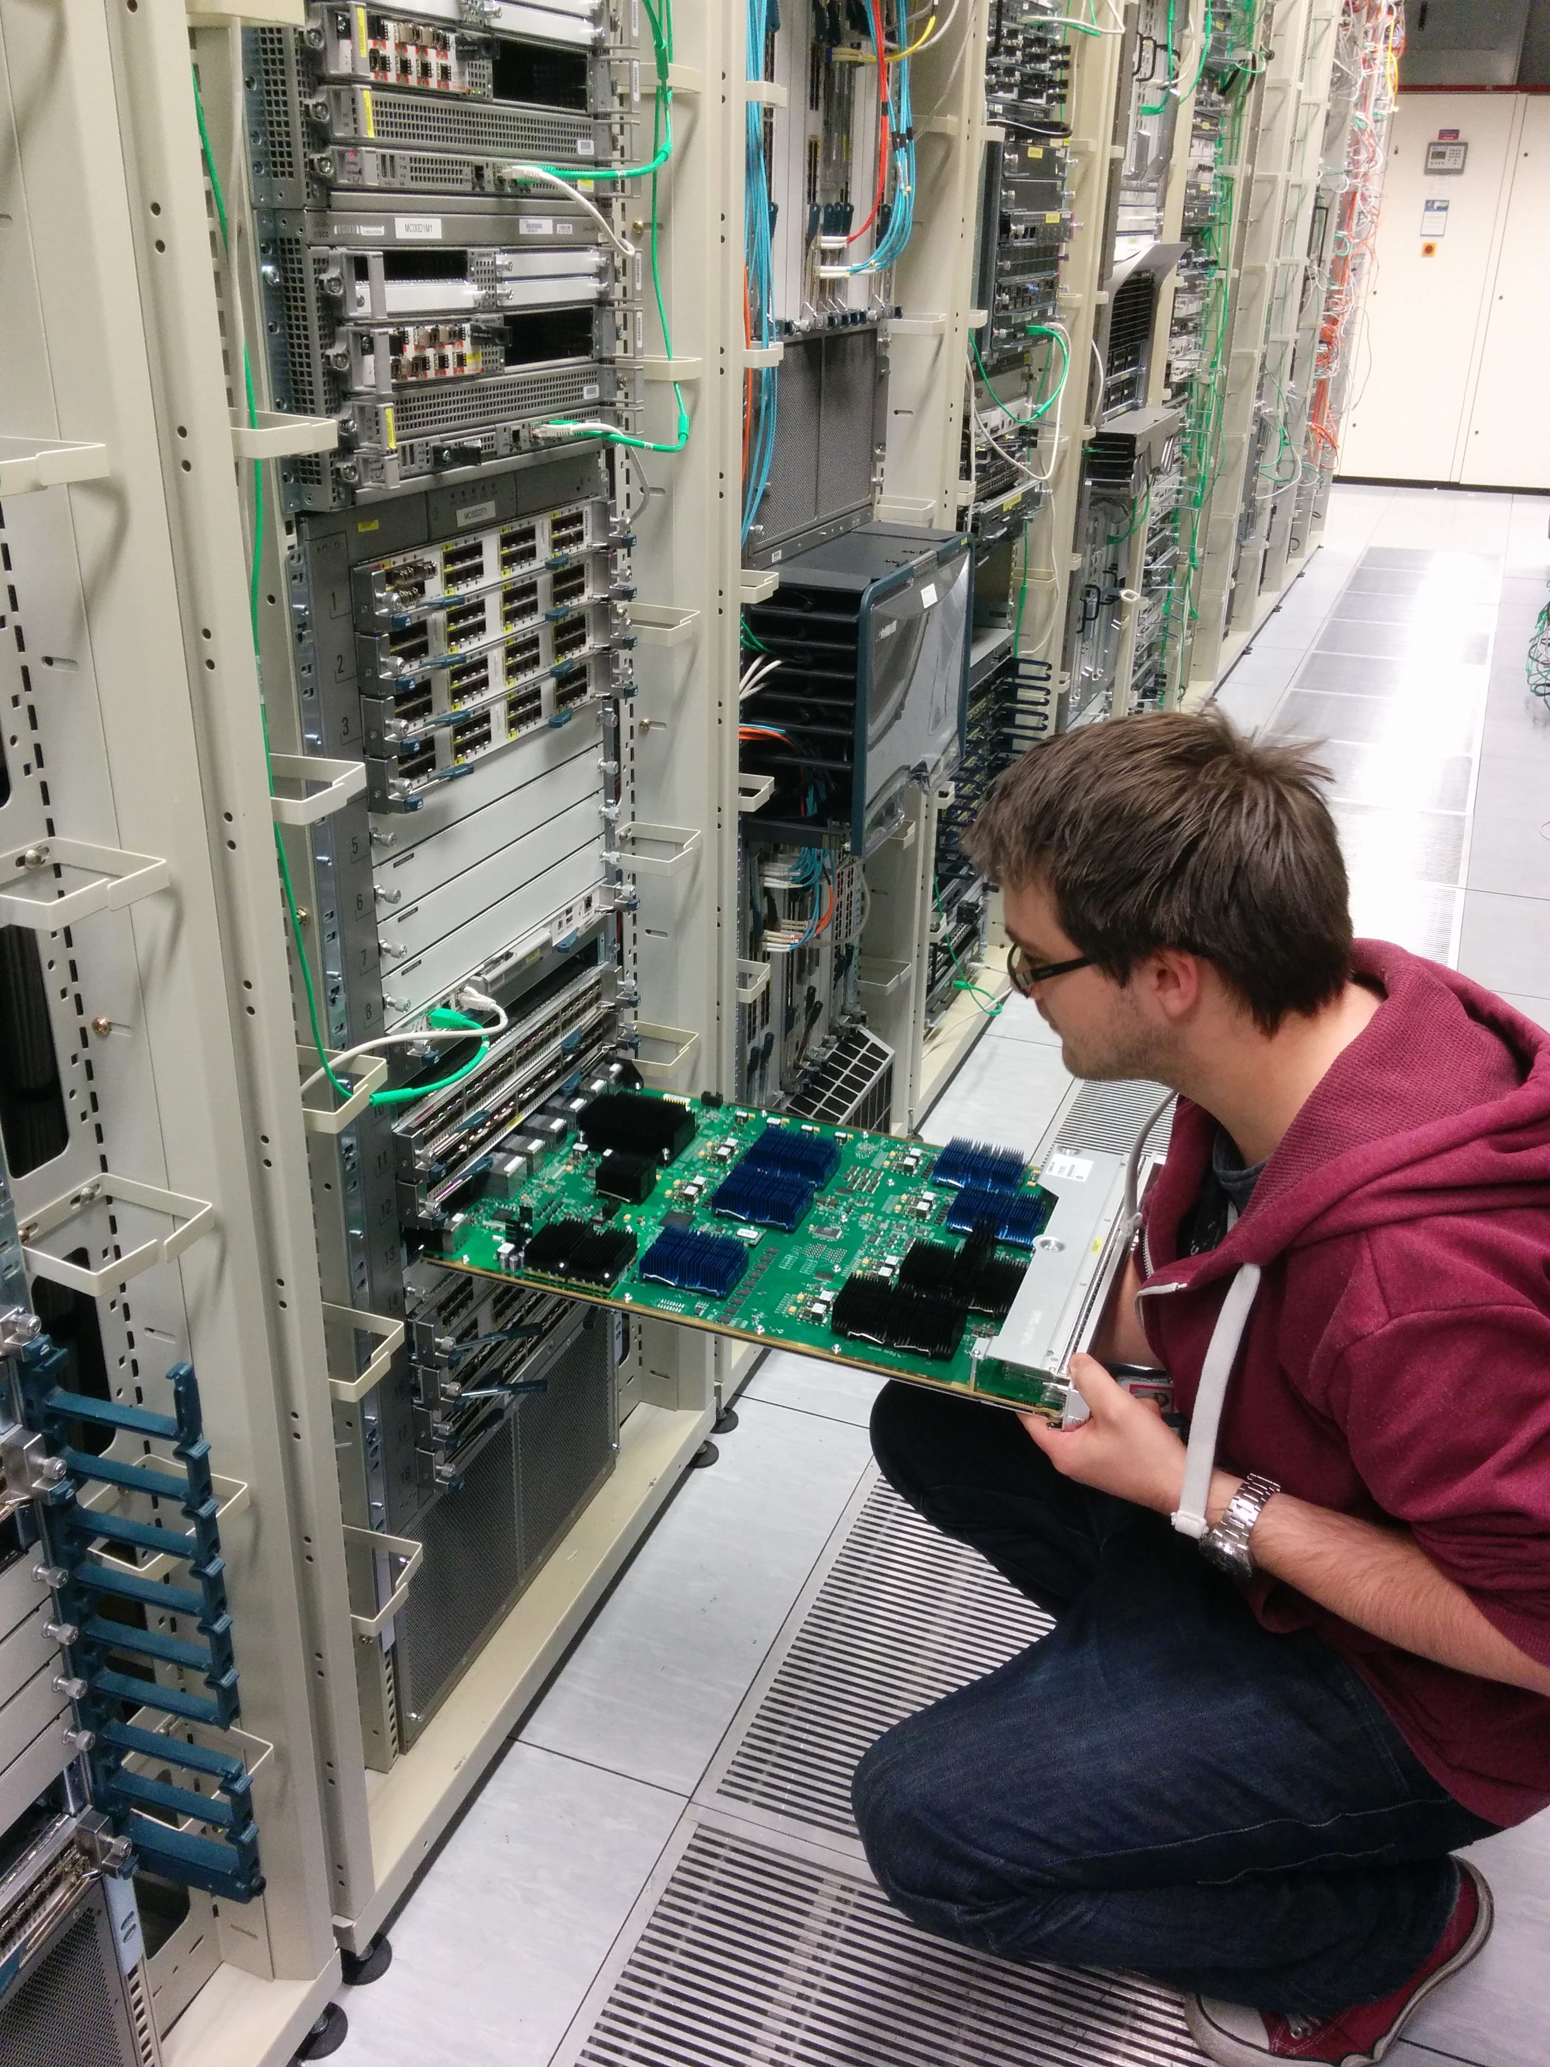

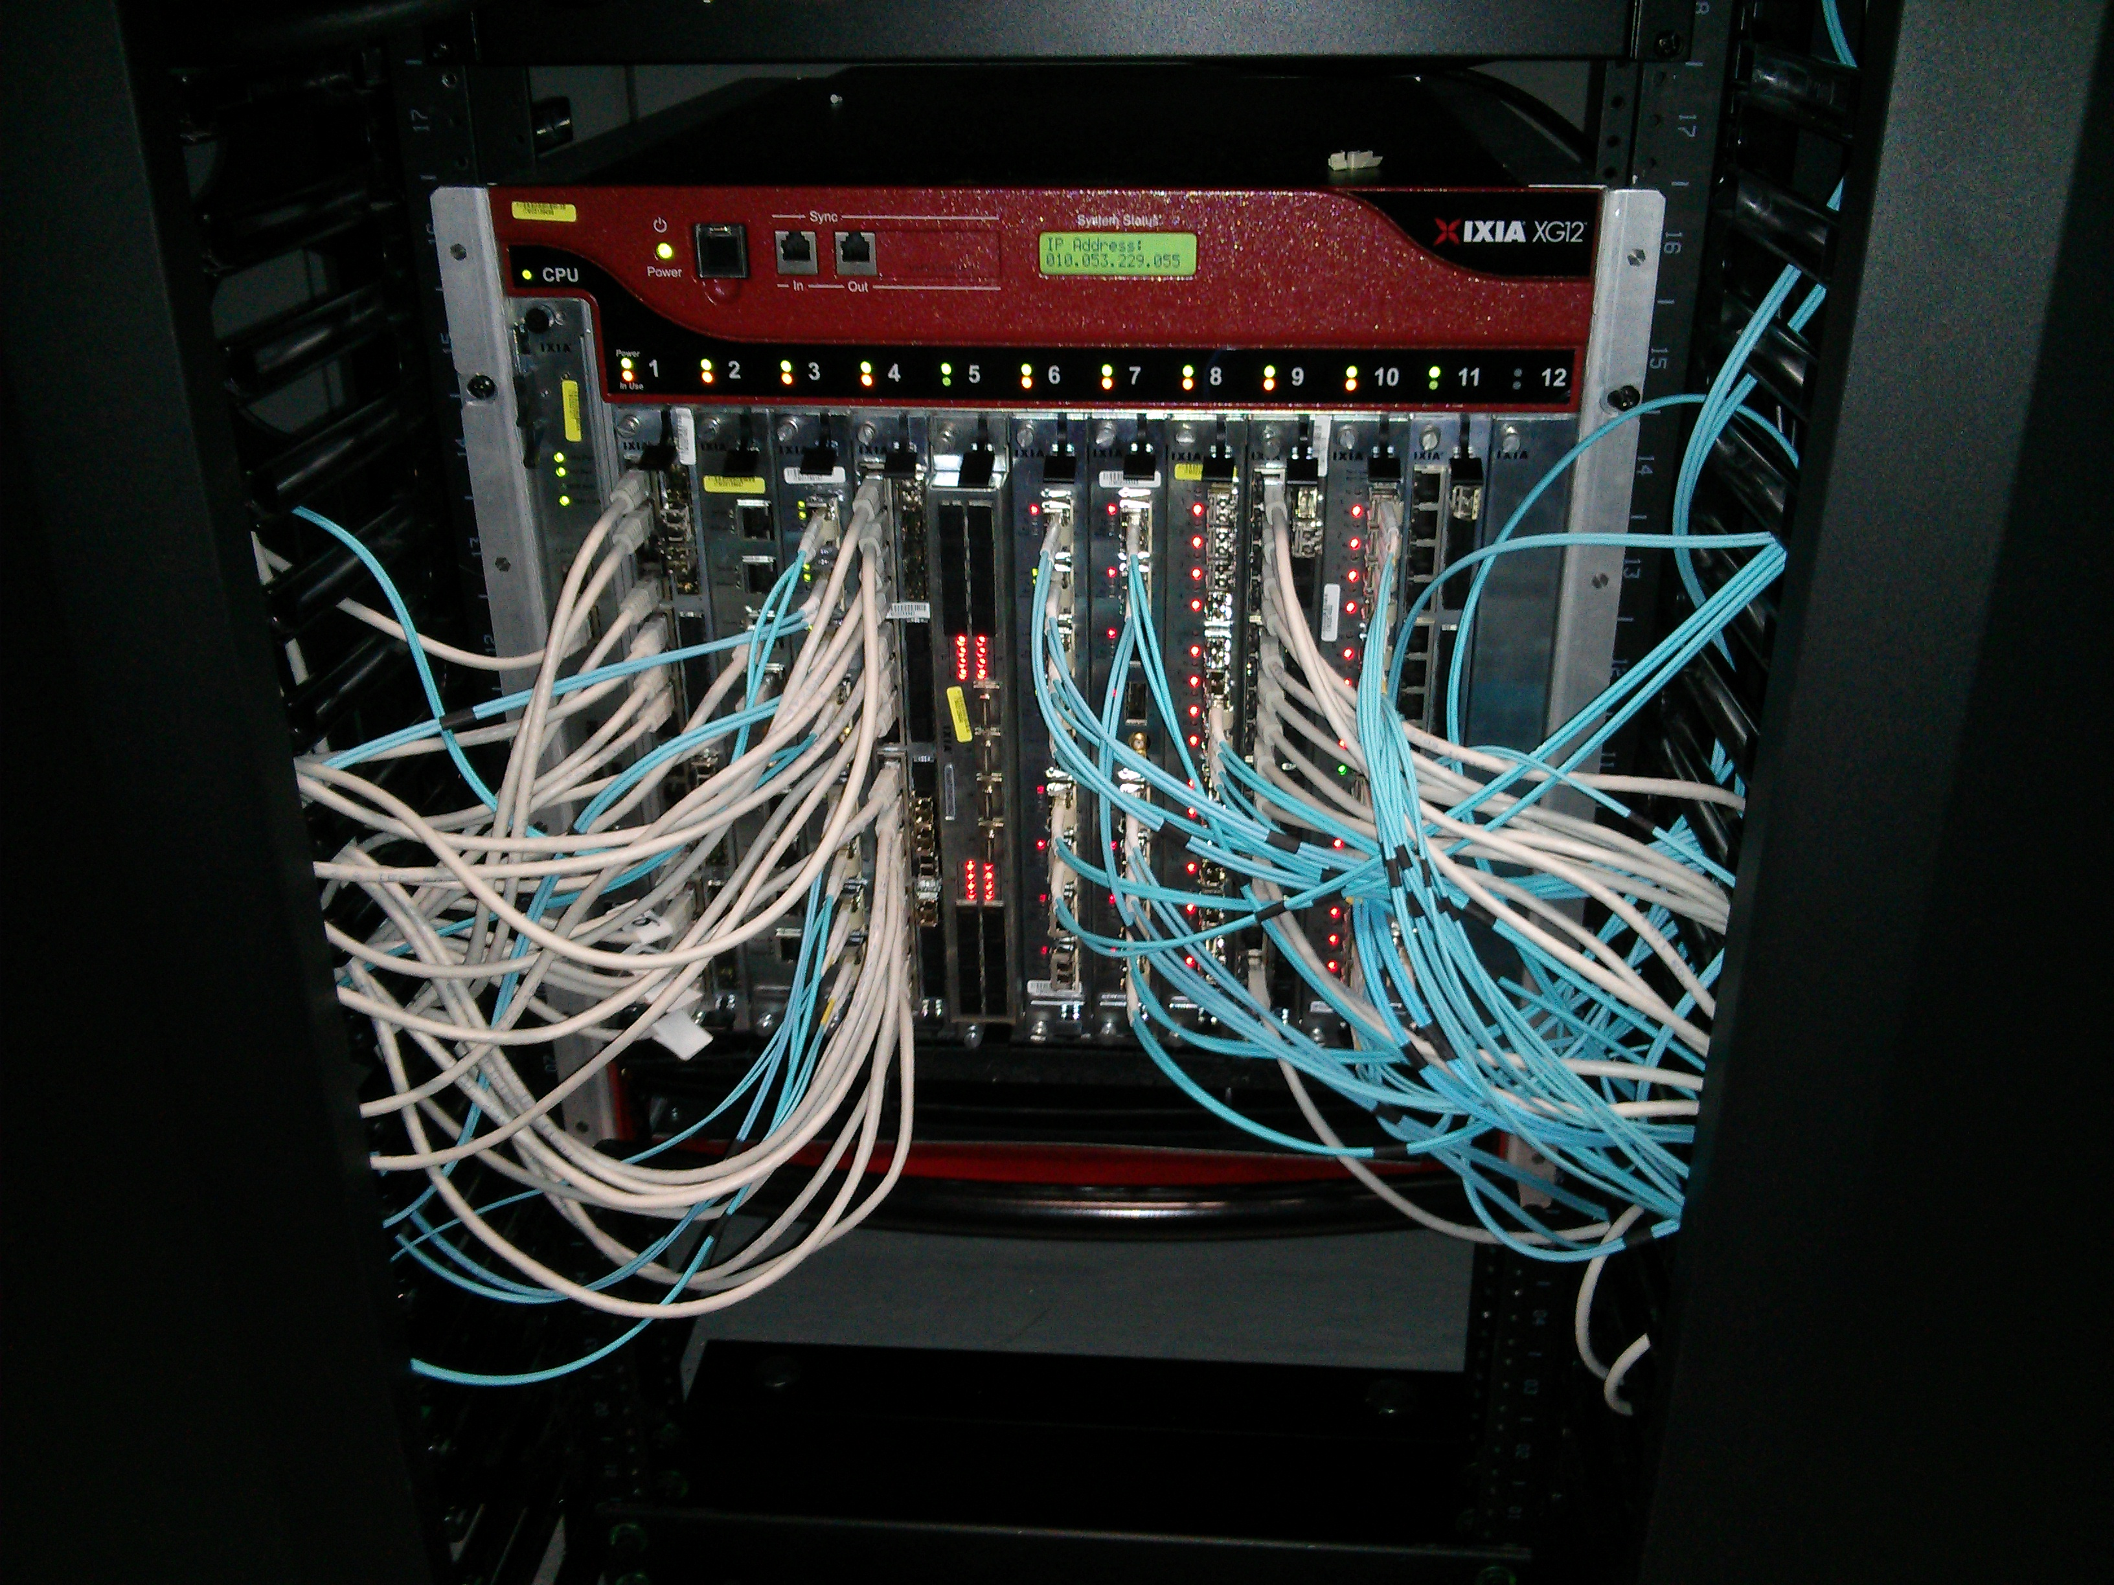

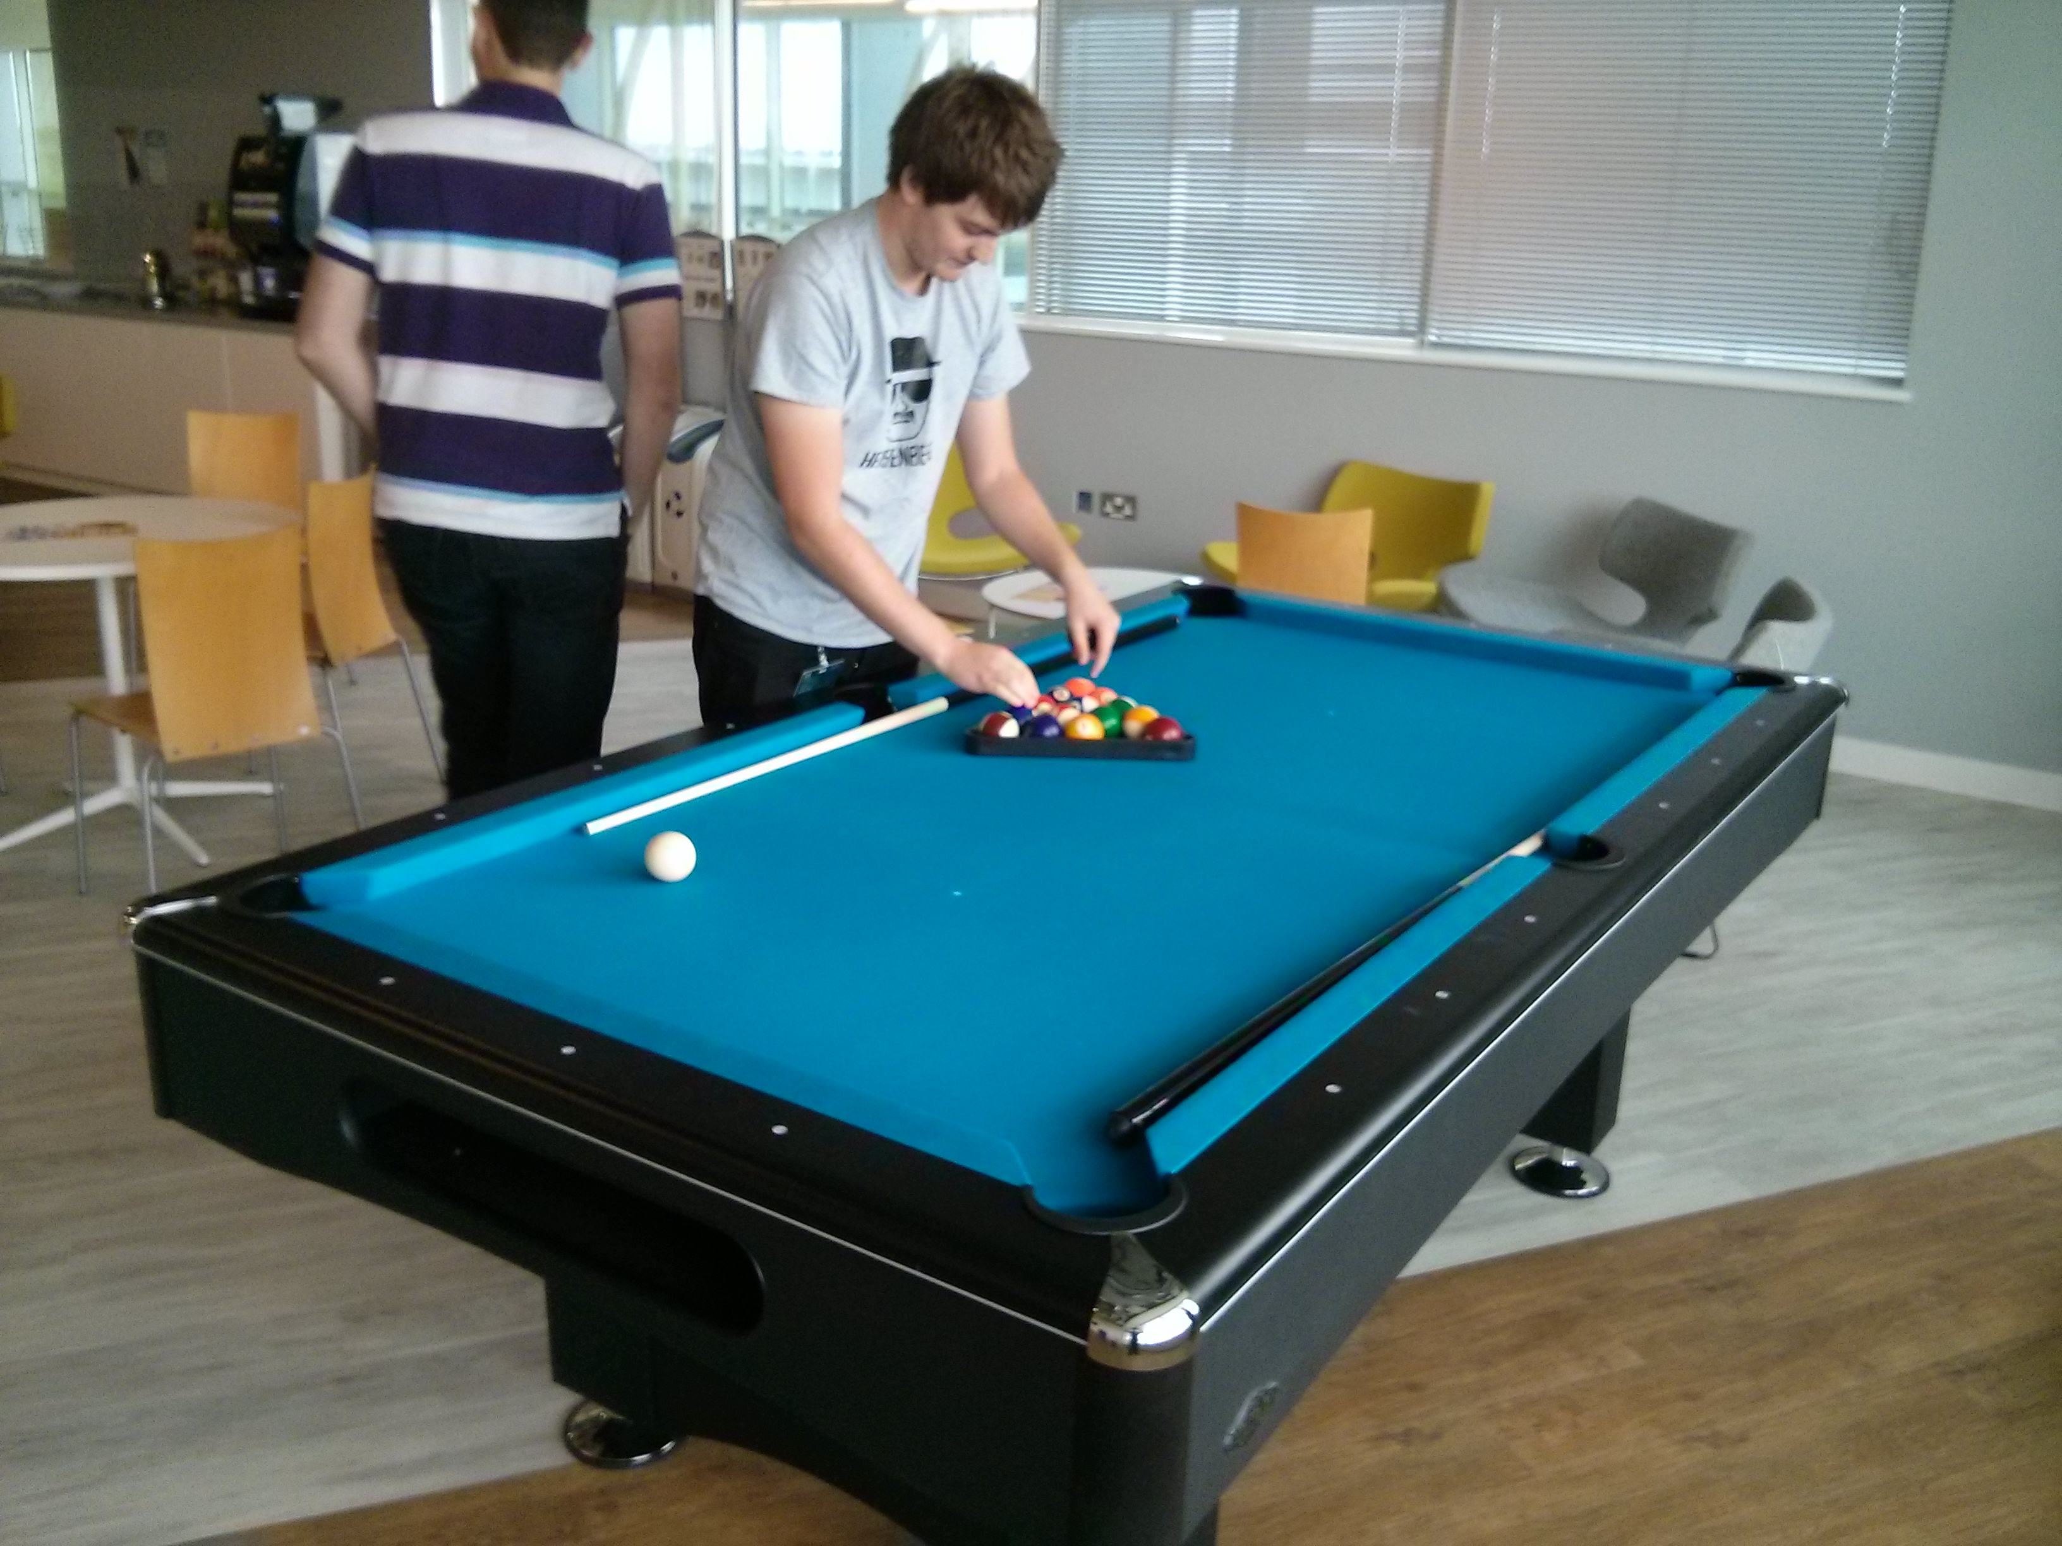
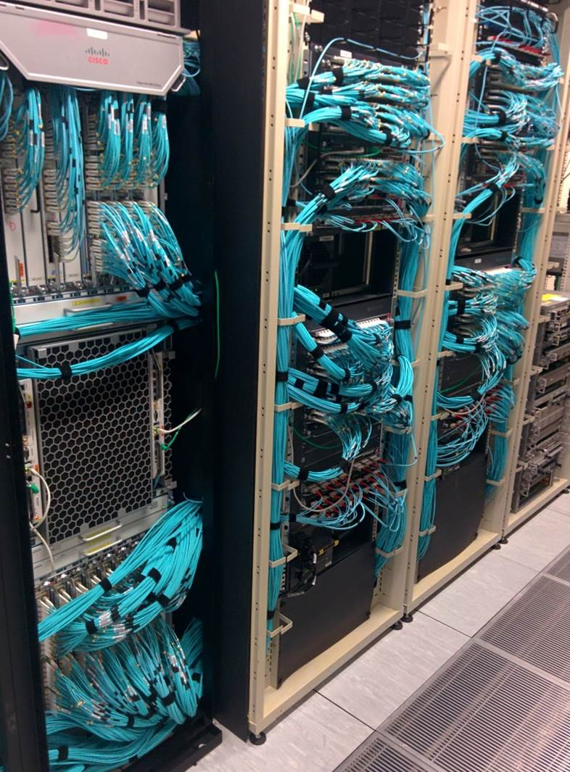
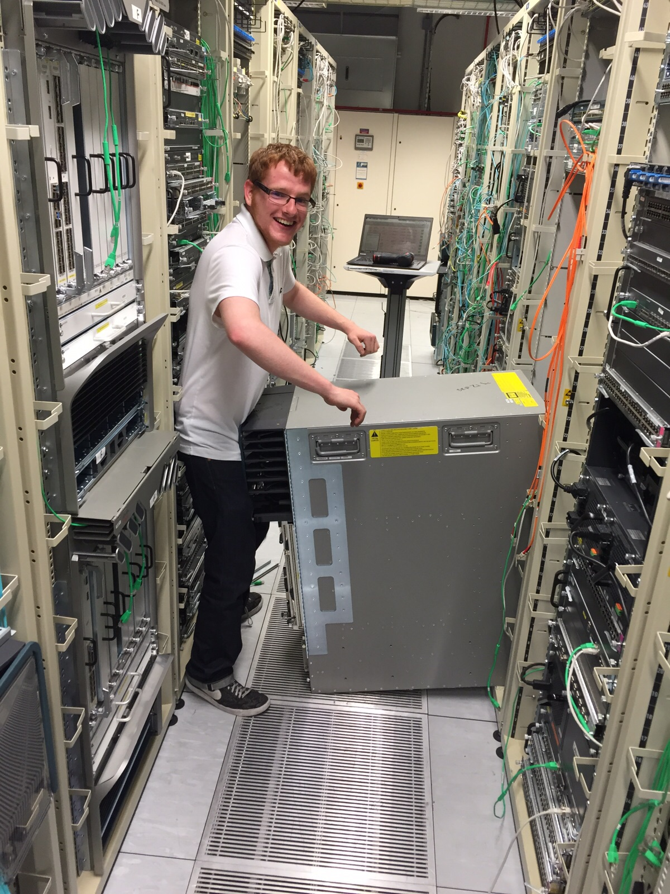
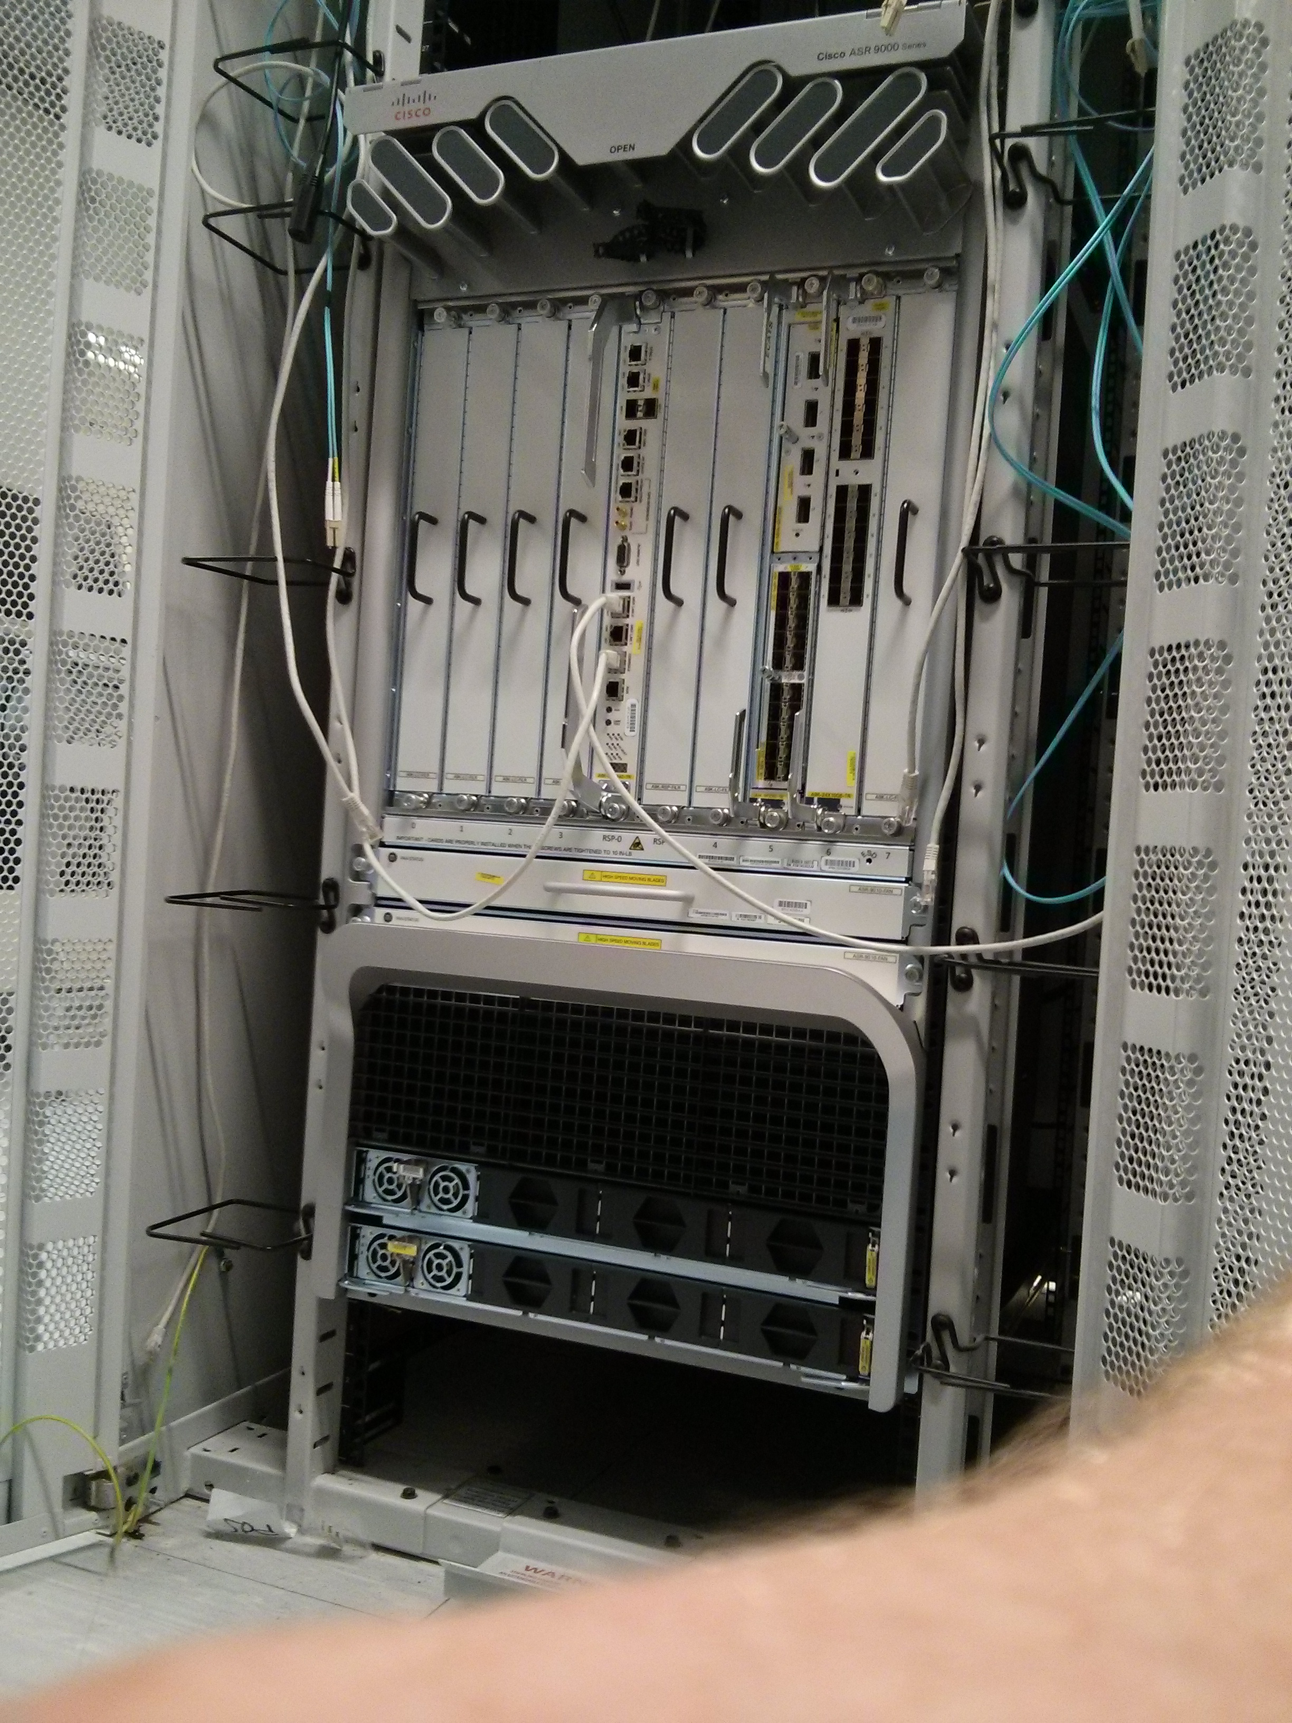

Slide 16
What we expect from applicants
CV
Detail previous accomplishments / experience relevant to the job
Include module results from first year, and final grade from College / A levels
Hobbies & other interests
Max 2 pages
Successful candidates should:
Be on track for a 2:1 or 1st in their degree
Be willing to learn, motivated and enthusiastic
Have excellent interpersonal, communication and teamwork skills
Able to quickly learn new technologies / pick up new skills
Notes:
----- Meeting Notes (22/10/2013 16:09) -----
Tim

Slide 17
Apply NOW! Deadline: November 8th
Position name: Networking Engineer - Bachelor/Master (Intern) - UK
Our Process:
CV Review
Invite candidates for telephone interview (no online assessment)
Invite successful candidates from phone interviews to assessment center
Apply at Cisco Jobs
https://jobs.cisco.com/jobs/ProjectDetail/Network-Engineer-Intern-Bachelors-CX-Labs/1276901

Slide 18
Q&A

Slide 19


Thank You
Questions
https://www.linkedin.com/in/archie-mcmaster/
https://www.linkedin.com/in/jordan-neville-54a315151/
3nevij31@slent.ac.uk
3mcmaa51@solent.ac.uk

